Slide 1
Alleles from VCF project
Dave Barton
Ed Louis

Slide 2
Quantitative Trait Loci (QTL) analysis
Platereader
output
Genotype files
(e.g. AESW12fc genotypes.csv)
PHENOS
software
R/qtl

Slide 3
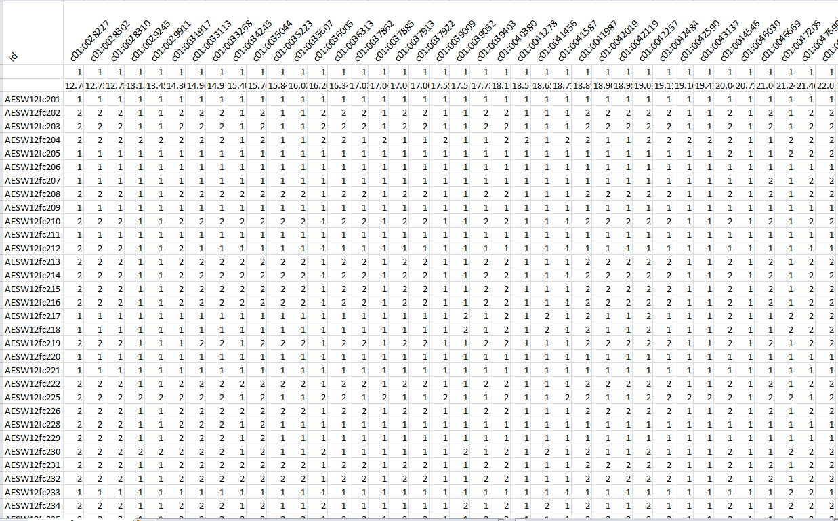
Genotype file (.csv)

Slide 4
Quantitative Trait Loci (QTL) analysis
VCF file
(e.g. Filtered_variants4e_DP3_DP100_
MISSING_1_H_MAC.recode.vcf)
Tom’s scripts
Platereader
output
Genotype files
(e.g. AESW12fc genotypes.csv)
PHENOS
software
R/qtl

Slide 5
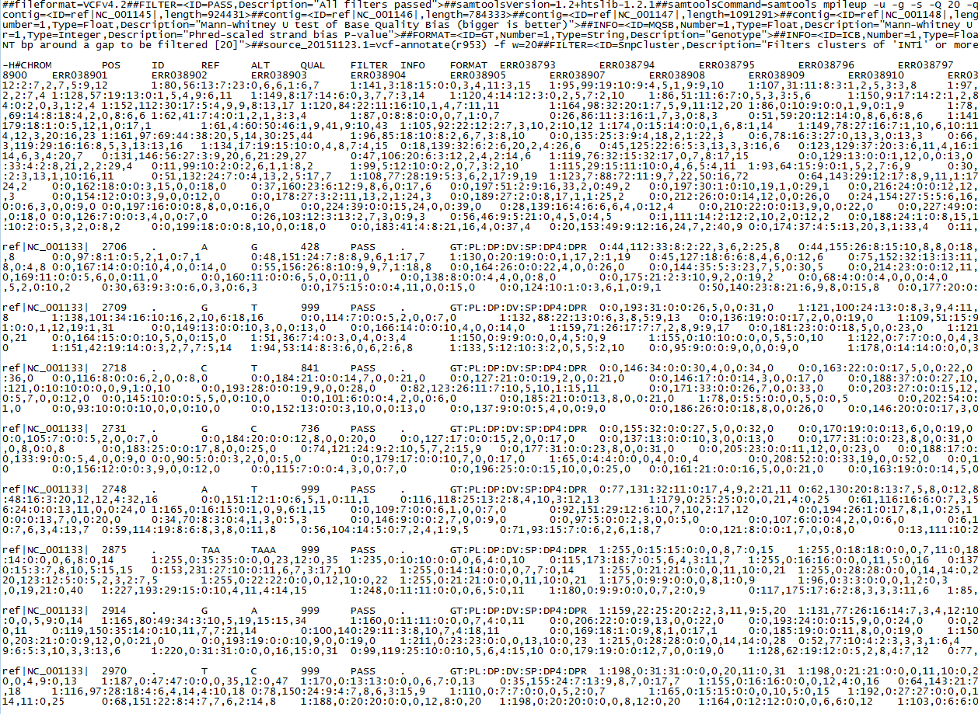
Variant Call Format (VCF) file

Slide 6
Quantitative Trait Loci (QTL) analysis
VCF file
(e.g. Filtered_variants4e_DP3_DP100_
MISSING_1_H_MAC.recode.vcf)
Tom’s scripts
Platereader
output
Genotype files
(e.g. AESW12fc genotypes.csv)
PHENOS
software
R/qtl

Slide 7
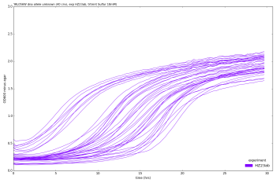
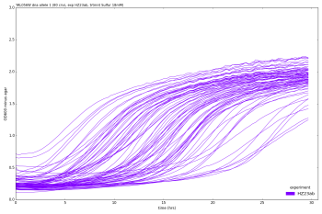
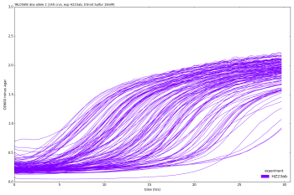
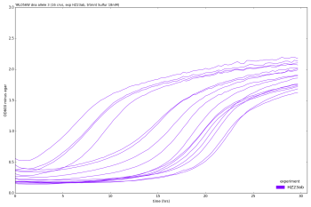
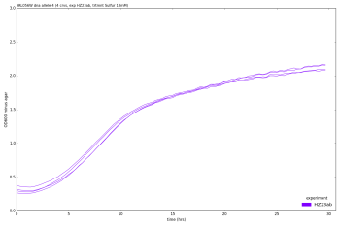
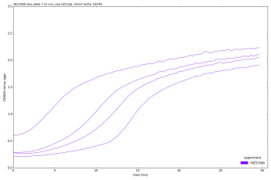
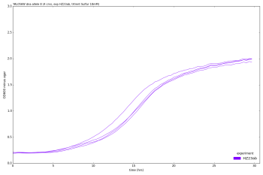
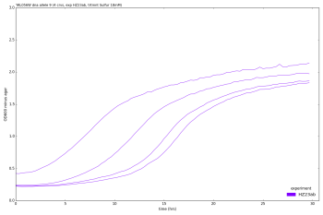
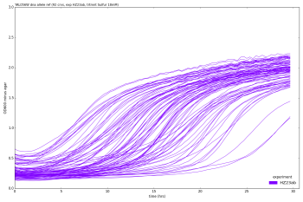
Alleles From VCF
VCF file
(e.g. Filtered_variants4e_DP3_DP100_
MISSING_1_H_MAC.recode.vcf)
GFF file
(e.g. saccharomyces_cerevisiae_
R64-2-1_20150113.gff)
Tom’s scripts
AFVCF
Platereader
output
Genotype files
(e.g. AESW12fc genotypes.csv)
AFVCF allele details Filtered_variants4e_DP3_DP100_MISSING_1_H_MAC.recode.txt
AFVCF dna allele per strain Filtered_variants4e_DP3_DP100_MISSING_1_H_MAC.recode.tab
PHENOS
software
AFVCF protein allele per strain Filtered_variants4e_DP3_DP100_MISSING_1_H_MAC.recode.tab
R/qtl

Slide 8
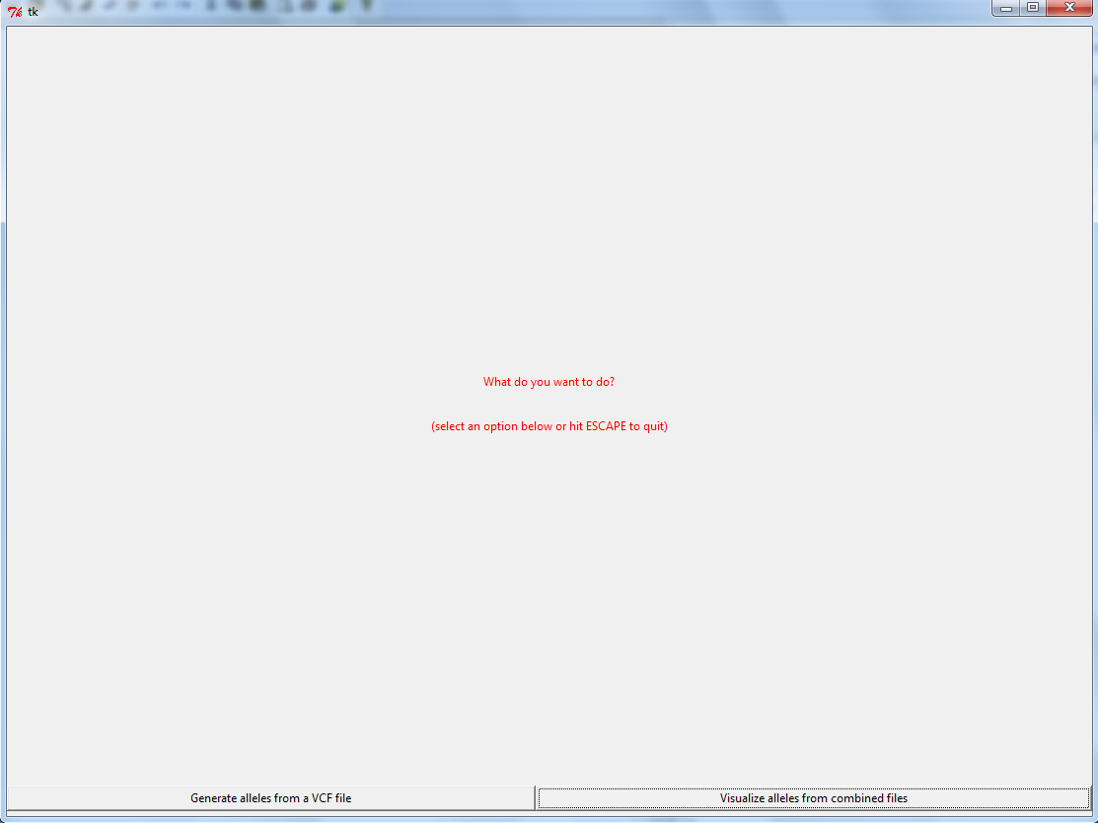
VCF file
(e.g. Filtered_variants4e_DP3_DP100_
MISSING_1_H_MAC.recode.vcf)
GFF file
(e.g. saccharomyces_cerevisiae_
R64-2-1_20150113.gff)

Slide 9
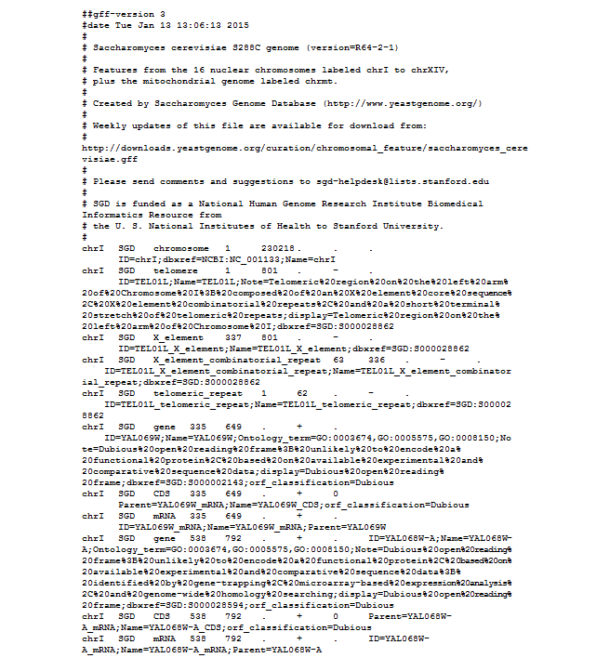
Reference genome (GFF) file

Slide 10
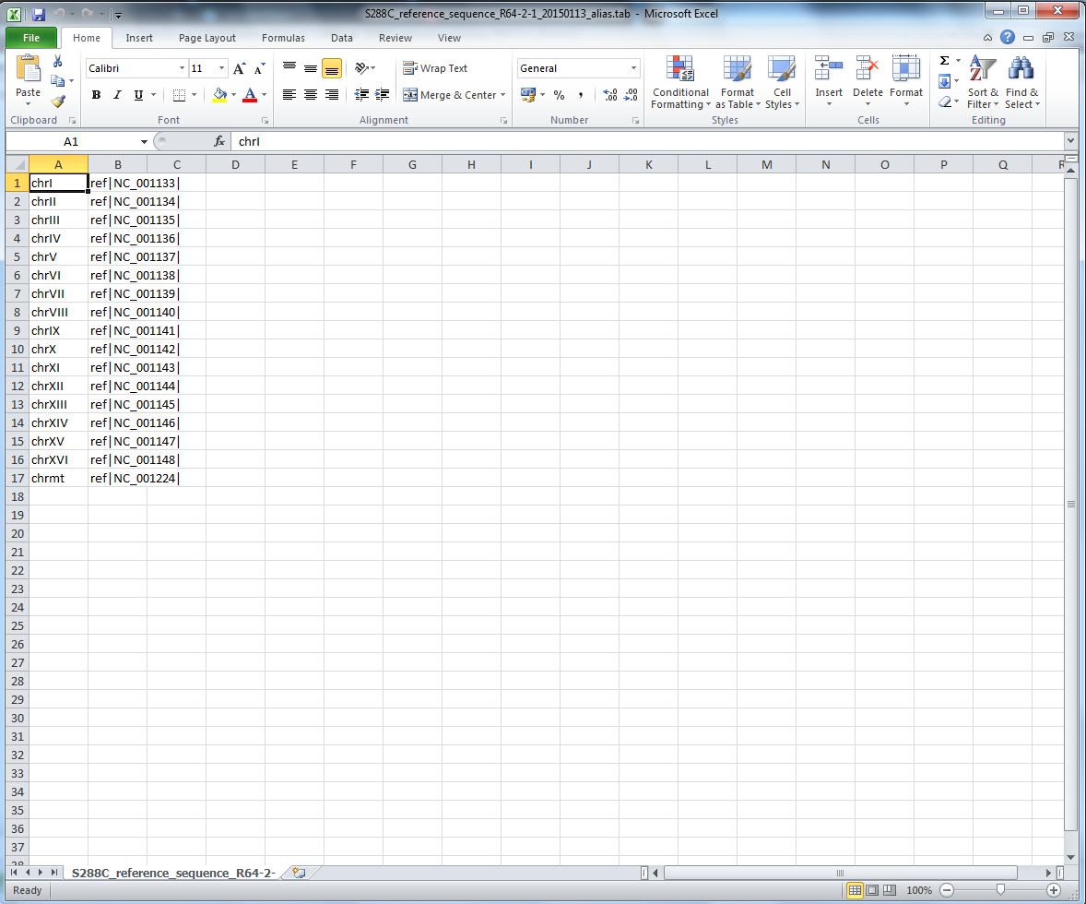
Chromosome alias file (.tab)

Slide 11
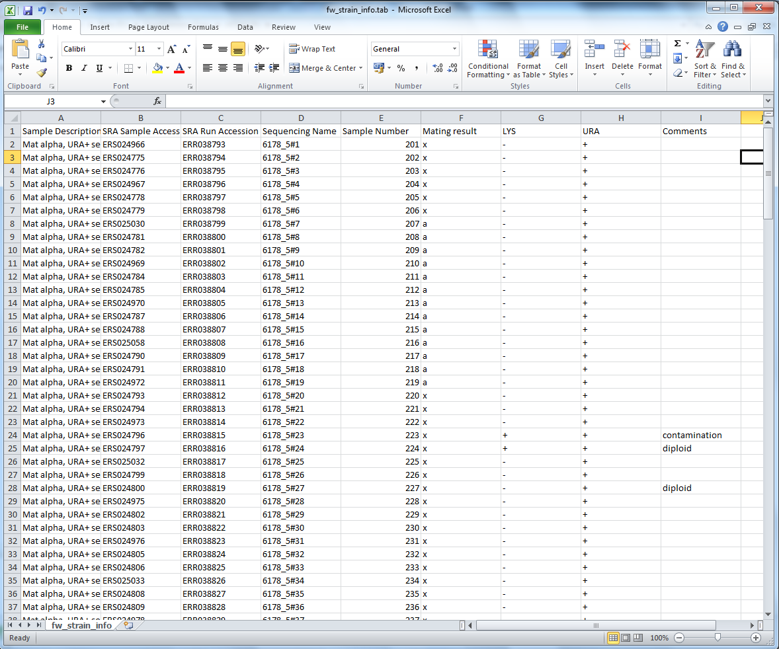
Strain alias file (.tab)

Slide 12
Output

Slide 13
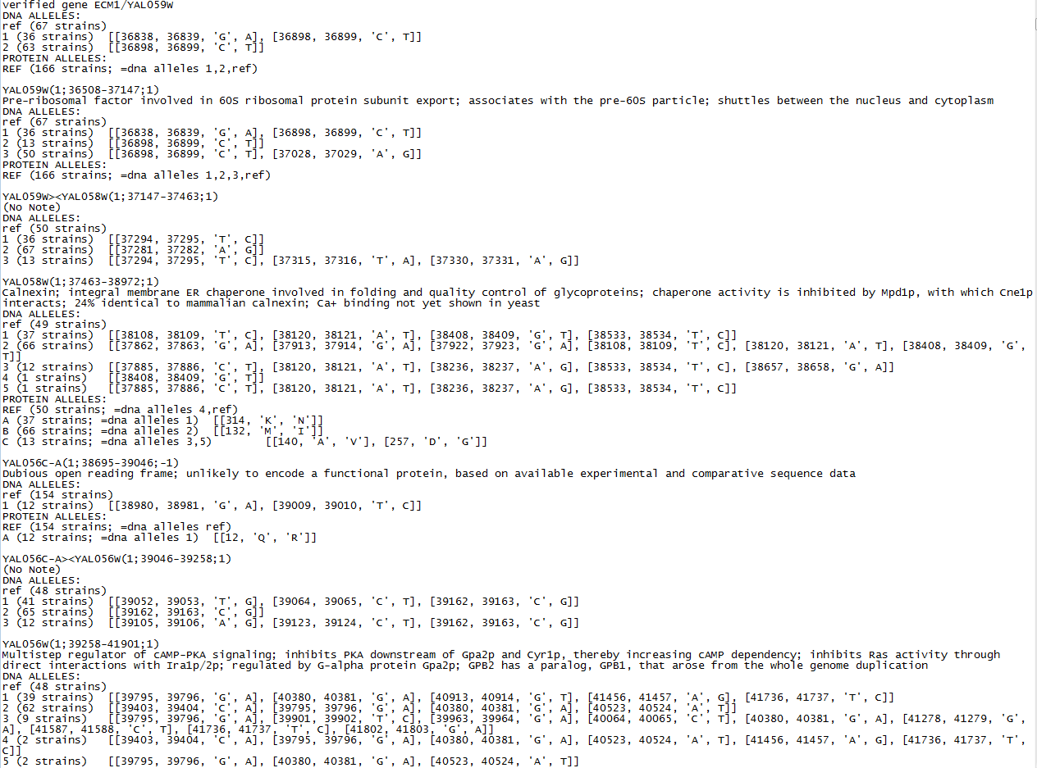
Allele details

Slide 14
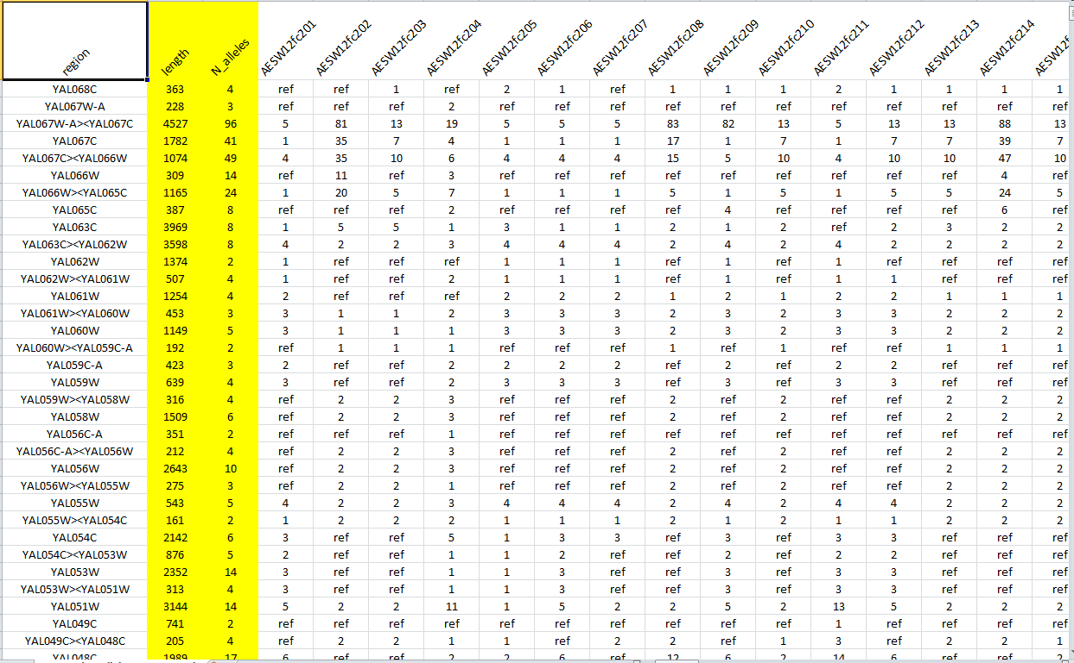
DNA alleles per strain

Slide 15
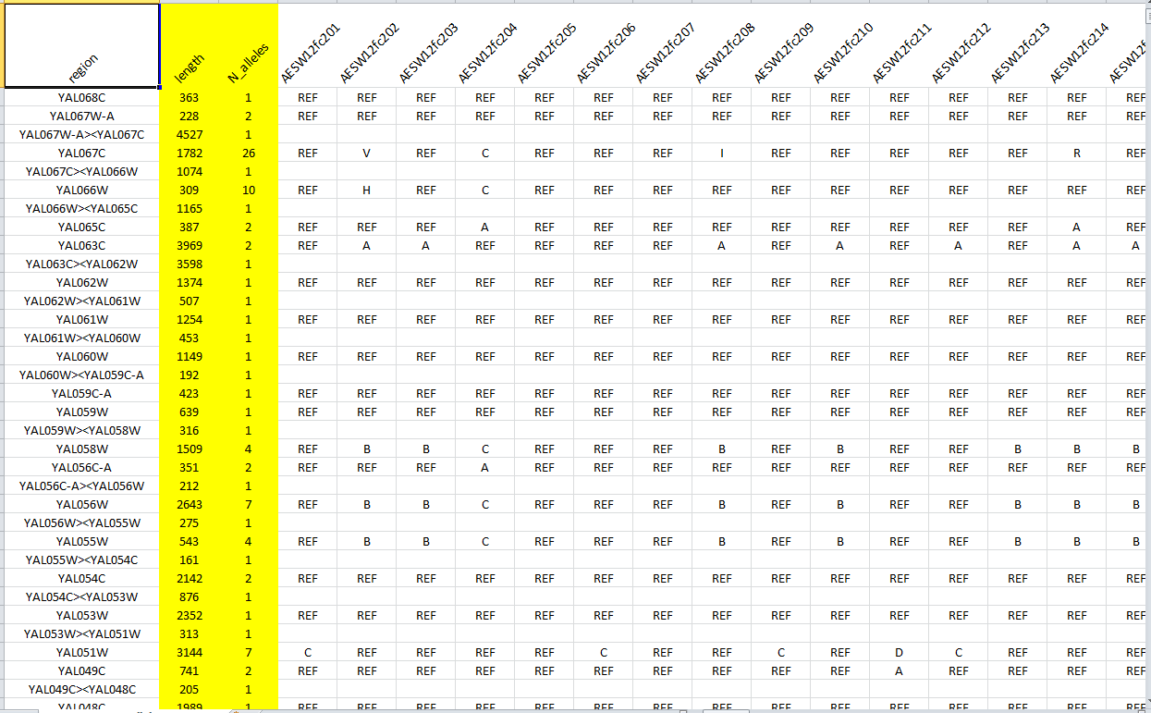
Protein alleles per strain

Slide 17
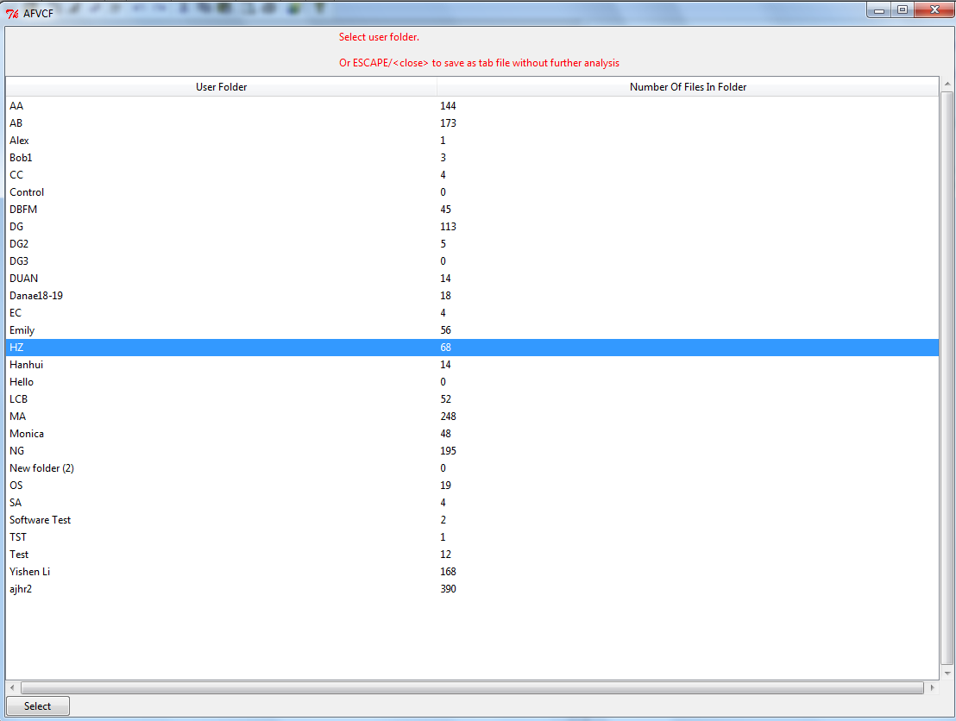

Slide 18
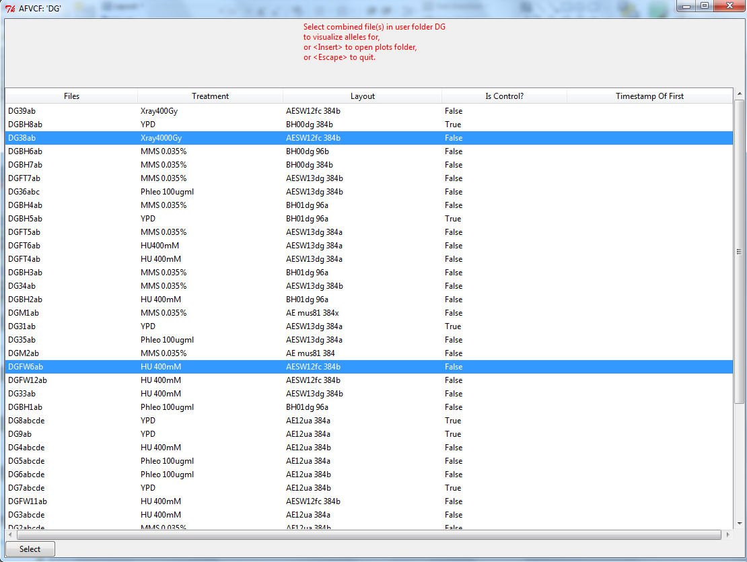

Slide 19
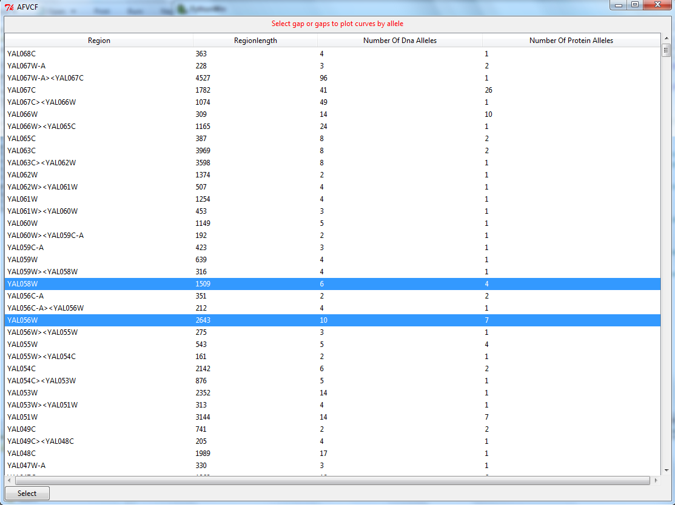

Slide 20
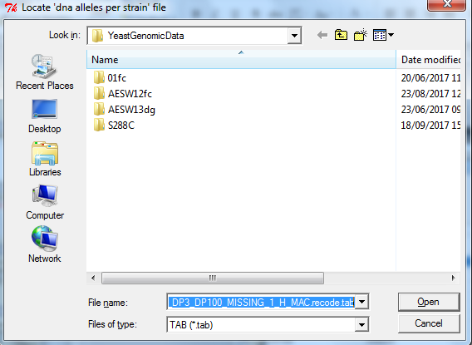

Slide 21
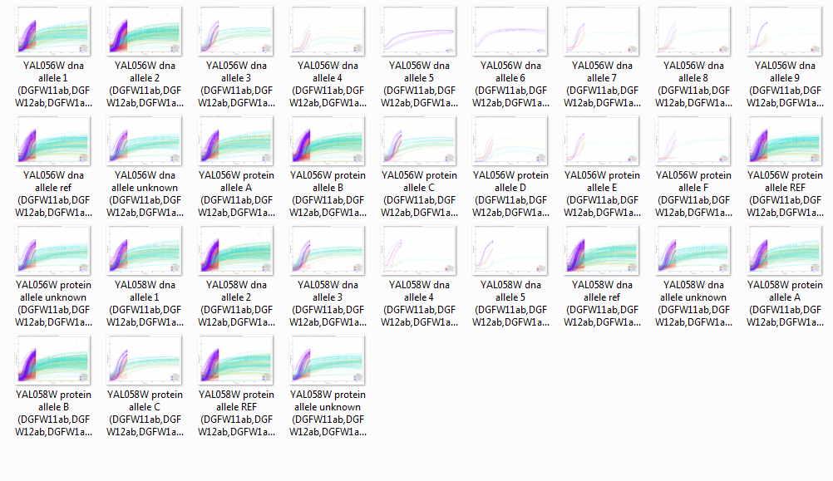

Slide 22
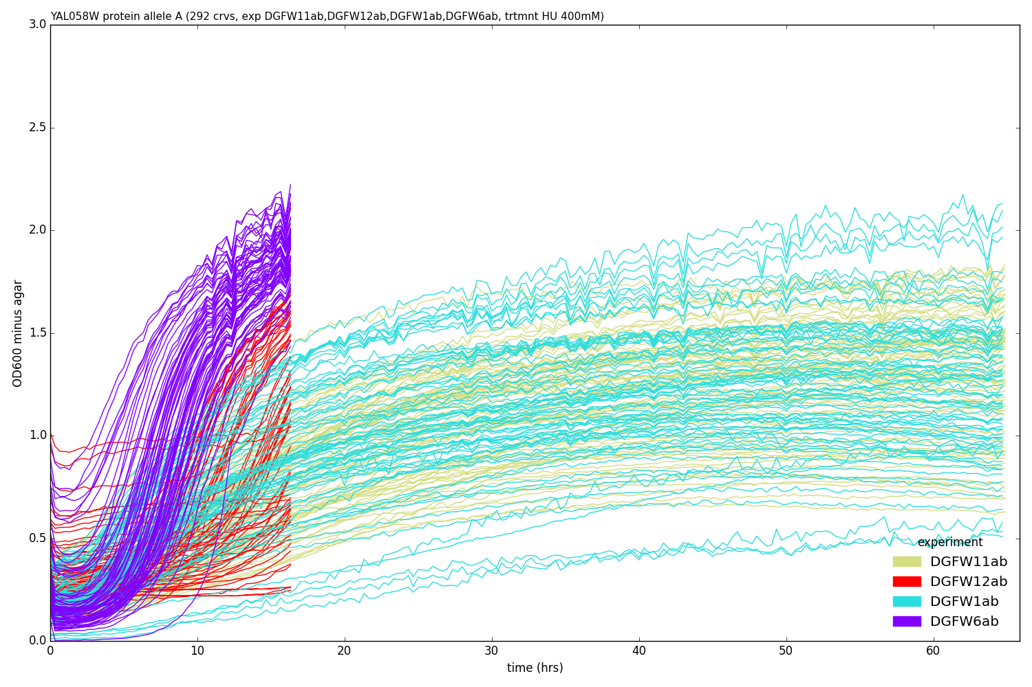

Slide 23
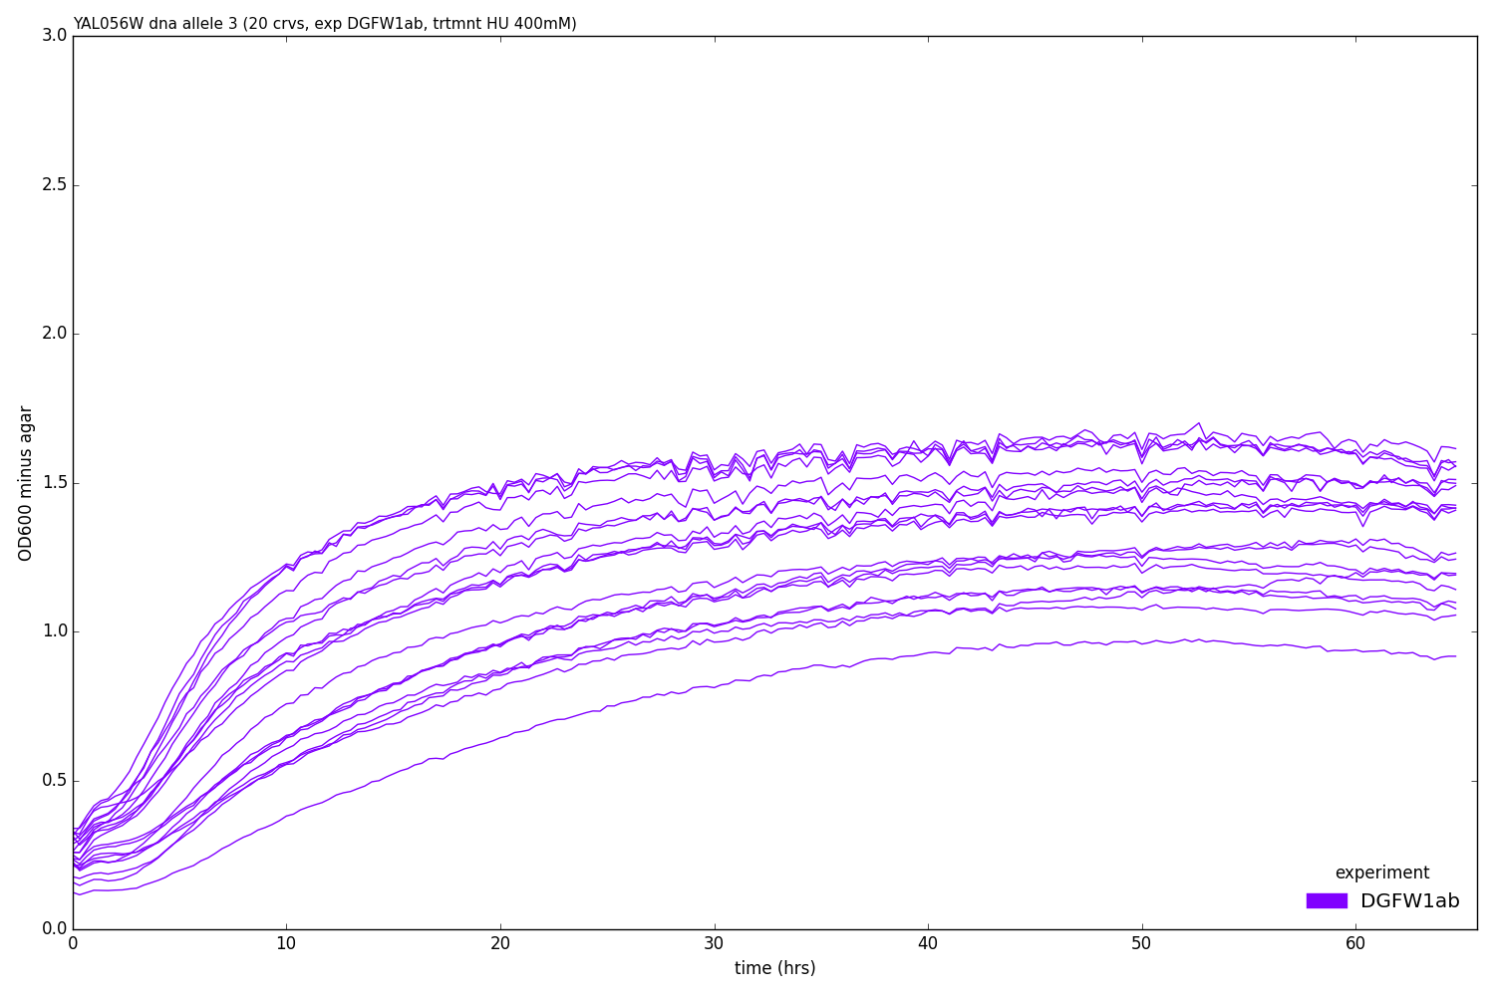

Slide 24
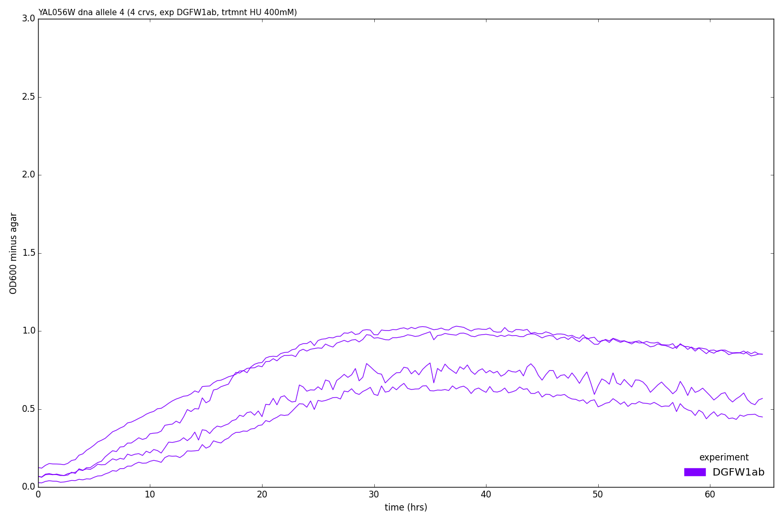

Slide 25
Watch out!
Files must be correct format.
Files must match.
There are multiple VCF files with different levels of stringency – some produce too many alleles, some too few
In complex genetics the key factors probably aren’t the different alleles of one gene but combinations of alleles from multiple genes.

